Slide 1
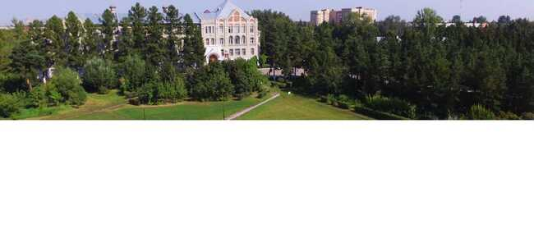
Omsk State Agrarian University
named after P.A. Stolypin
"Preserving traditions, introducing innovations"

Slide 2




Omsk SAU - state university under the jurisdiction of the Ministry of Agriculture of the Russian Federation
STATE UNIVERSITY – a part of the higher educational system
SECTORIAL UNIVERSITY– a part of the Russian agro-industrial complex
HUMAN RESOURCE CENTER of the regional agro-industrial cluster
Omsk SAU DIPLOMAS are recognized all over the world
Shumakova Oksana Victorovna, Rector, Doctor of economics, Professor

Slide 3






4
2
place
place
IN THE RANKINGS
in the ranking of the Ministry of Agriculture of the Russian Federation
among the Omsk universities
2
4
3
5
place
place
place
place
in the international ranking among agrarian universities of the country
in the global ranking of Web popularity among Omsk Universities
among agrarian universities
among agrarian universities

Slide 4





OMSK SAU IS A GLOBAL CENTER OF CONTINUOUS EDUCATION, CULTURE, INNOVATION AND SCIENTIFIC ACHIEVEMENTS FOR PROMISING TECHNOLOGICAL UPDATE OF THE AGRICULTURAL SECTOR.
ESTABLISHED IN 1918 NUMBER OF STUDENTS 9800 DORMITORY PLACES 4010
120 EDUCATIONAL PROGRAMS 66 TRAINING DIRECTIONS 24 SCIENTIFIC SCHOOLS
INTERNATIONAL COLLABORATIONS
Silkroad Agricultural Education and Research Innovation Alliance
University of Shanghai Cooperation Organization
International Program of the Kazakhstan-Siberian Wheat Improvement Network (KASIB)

Slide 5


FACULTIES OF OMSK SAU
PROGRAMS OF HIGHER
EDUCATION
AGROTECHNOLOGICAL FACULTY
FACULTY OF AGROCHEMISTRY, SOIL SCIENCES, ECOLOGY, ENVIRONMENTAL ENGINEERING, AND WATER RESOURCE EXPLOITATION
FACULTY OF VETERINARY MEDICINE
FACULTY OF LAND MANAGEMENT
FACULTY OF TECHNICAL SERVICE OF AGROINDUSTRIAL COMPLEXES
FACULTY OF ZOOTECHNY, COMMODITY SCIENCE AND STANDARDIZATION
FACULTY OF ECONOMICS
DEPARTMENT OF POSTGRADUATE AND DOCTORAL STUDIES
TARA BRANCH
UNIVERSITY COLLEGE OF AGRIBUSINESS
1 PREPARATORY DEPARTMENT FOR FOREIGN CITIZENS
2 SPECIALIST PROGRAMS
24 BACHELOR PROGRAMS
22 MASTER PROGRAMS
24 PhD PROGRAMS
Tuition fees range from USD 1,800 to USD 2,500 per year (as of September 1, 2025)
ADMISSION OF FOREIGN CITIZENS FOR STUDY IN THE 2026/27 ACADEMIC YEAR IS CARRIED OUT
AT THE EXPENSE OF BUDGETARY APPROPRIATIONS IN ACCORDANCE WITH INTERNATIONAL TREATIES OF THE RUSSIAN FEDERATION, FEDERAL LAWS BASED ON THE RESULTS OF AN INTERNAL COMPETITION
WITHIN THE QUOTA ESTABLISHED BY THE GOVERNMENT OF THE RUSSIAN FEDERATION FOR THE EDUCATION OF FOREIGN CITIZENS FOR THE 2026/27 ACADEMIC YEAR
IN ACCORDANCE WITH AGREEMENTS FOR THE PROVISION OF PAID EDUCATIONAL SERVICES
BASED ON THE RESULTS OF AN INTERNAL COMPETITION

Slide 6
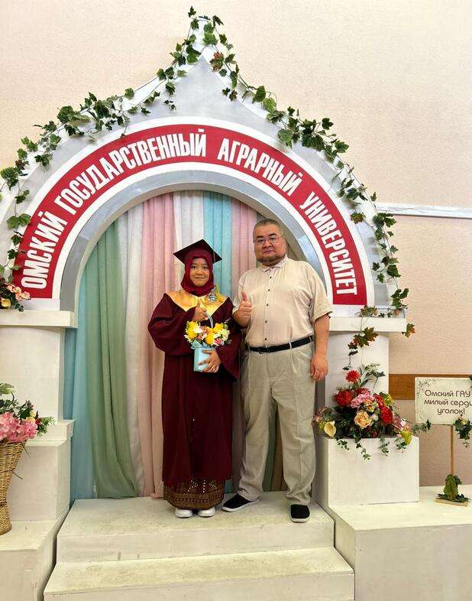



THE FOLLOWING PROGRAMS ARE AVAILABLE WITHING THE EDUCATIONAL QUOTA ESTABLISHED BE THE GOVERNMENT OF THE RUSSIAN FEDERATION FOR FOREIGN STUDENTS FOR 2026/2027
BACHELOR DEGREE
19.03.02 Food products of plant origin
35.03.04 Agronomy
35.03.06 Agricultural engineering
SPECIALIST DEGREE PROGRAMS
36.05.01 Veterinary Medicine
MASTER’S DEGREE PROGRAMS
05.04.06 Ecology and environmental engineering
19.04.02 Food products of plant origin
20.04.02 Environmental engineering and water-use
21.04.02 Land management and cadastres
35.04.03 Agrochemistry and agrosoil sciences
35.04.04 Agronomy
35.04.06 Agricultural engineering
36.04.01 Veterinary and sanitary examination
36.04.02 Zootechny
38.04.02 Management
POSTGRADUATE PROGRAMS
4.1.2 Plant Breeding, Seed Production and Biotechnology
FOR INDIVIDUAL CONSULTATION FOLLOW THE LINK OF QR-CODE
https://forms.gle/YLwvif9UtB1BGw2q6

Slide 7
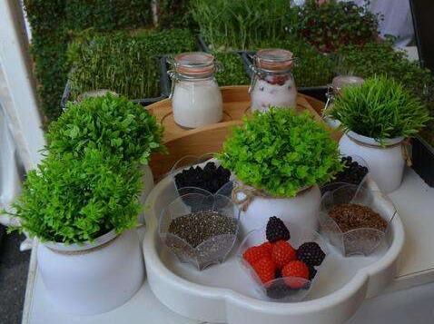
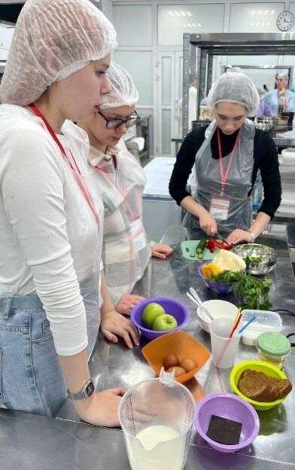
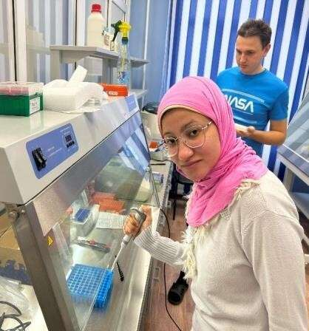
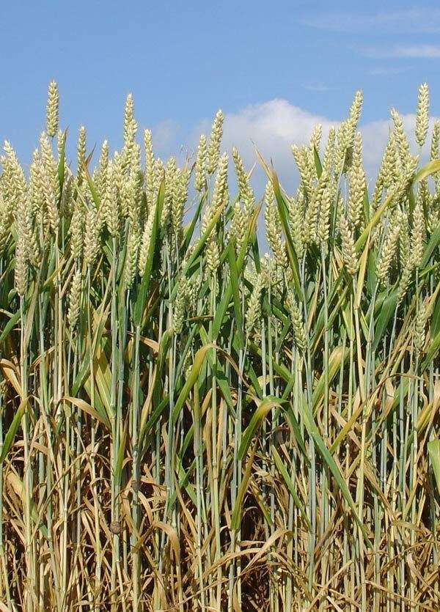

AGROTECHNOLOGICAL FACULTY
BACHELOR'S DEGREE PROGRAMS
19.03.01 Biotechnology
Food biotechnology
19.03.02 Food products from plant raw materials
Technology of bread, confectionery and pasta
19.03.03 Food products of animal origin
Technology of milk and dairy products
Technology of meat and meat products
35.03.01 Forestry
- Forestry
35.03.04 Agronomy
Agribusiness
Breeding and genetics of agricultural crops
Field farming
Plant protection
35.03.05 Gardening
- Fruit and vegetable growing and
viticulture
MASTER'S DEGREE PROGRAMS
19.04.01 Biotechnology
19.04.02 Food products from plant raw materials
Technology of food products from special-purpose plant raw materials
19.04.03 Food products of animal origin
Biotechnology of medical, special and preventive nutrition products
19.04.05 High-tech production of functional and specialized food products
High-tech production of functional and specialized food products
Technology of functional and specialized food products from raw materials of animal and vegetable origin
35.04.04 Agronomy
Adaptive crop production
Plant breeding, seed production and biotechnology
Sustainable agriculture and rural development
35.04.05 Gardening
- Fruit and vegetable growing
WE WILL TEACH YOU
- manage the processes of plant growth and development without leaving home or office
- change landscapes for a comfortable human life
- develop unique food products of the future
- design and launch ultra-modern processing enterprises

Slide 8
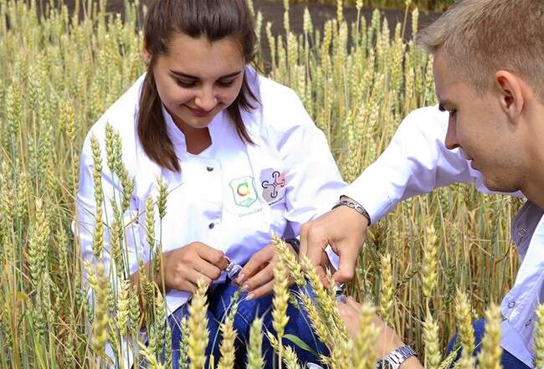
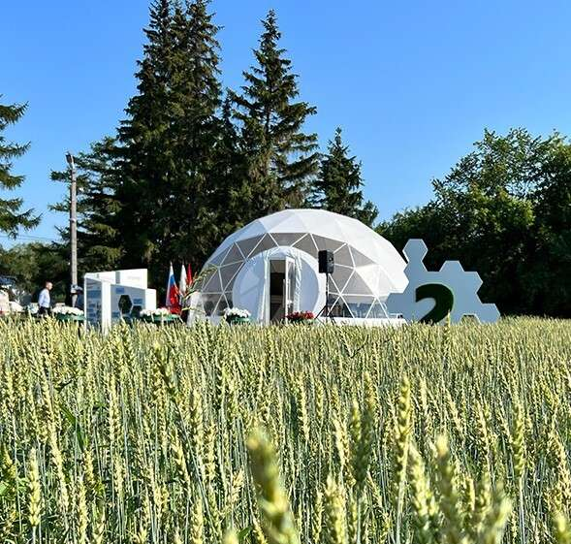

FACULTY OF AGROCHEMISTRY, SOIL SCIENCES, ECOLOGY, ENVIRONMENTAL ENGINEERING, AND WATER RESOURCE EXPLOITATION
BACHELOR'S DEGREE PROGRAMS
05.03.06 Ecology and environmental engineering
20.03.01 Technosphere safety
Life safety in the technosphere
20.03.02 Environmental engineering and water-use
Integrated use and protection of water resources
Engineering systems of agricultural water supply, irrigation and sanitation
Water resources management and water use
35.03.03 Agrochemistry and agro soil science
- Agroecology
35.03.11 Hydro amelioration
Hydro-reclamation
Construction
MASTER'S DEGREE PROGRAMS
05.04.06 Ecology and environmental engineering
- Ecology of the region
20.04.01 Technosphere safety
Environmental monitoring and protection
20.04.02 Environmental engineering and water-use
Water supply and sanitation
35.04.03 Agrochemistry and agro soil science
- Management of soil fertility and nutrition of cultivated plants
35.04.10 Hydro amelioration
Management of land reclamation systems
WE WILL TEACH YOU
use environmentally friendly agricultural technologies and biofertilizers for growing agricultural crops
solve practical problems in the field of environmental protection, rational use of natural resources and ensuring environmental safety of the population
predict and prevent, as well as eliminate the consequences of emergency situations
develop innovative projects for the reconstruction of environmental management and water use facilities
make professional decisions in the design, construction, supervision and control of hydraulic structures

Slide 9
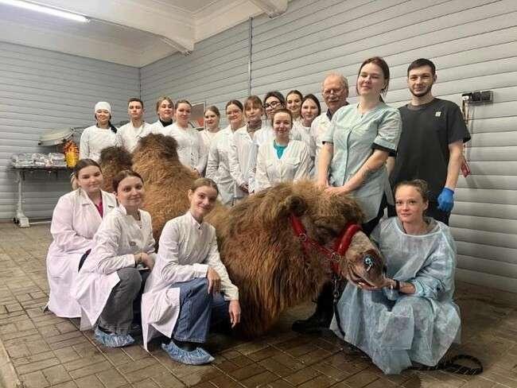
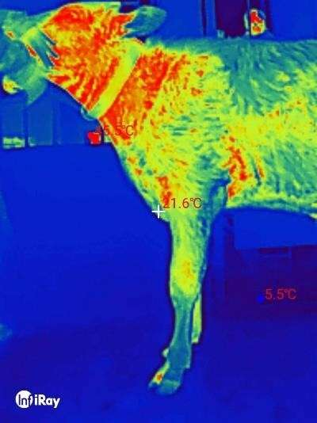
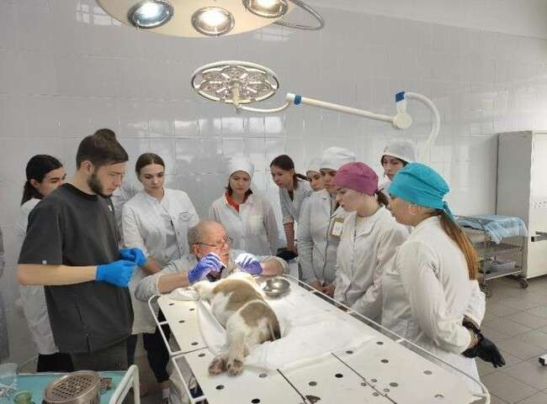
FACULTY OF VETERINARY MEDICINE
BACHELOR'S DEGREE PROGRAMS
36.03.01 Veterinary and sanitary examination
- Veterinary and sanitary examination of raw materials and products of animal and vegetable origin
Veterinary and sanitary medicine
SPECIALIST’S DEGREE PROGRAMS
36.05.01 Veterinary Medicine
MASTER'S DEGREE PROGRAMS
36.04.01 Veterinary and sanitary examination
- Veterinary and sanitary quality and safety
control of agricultural products
State veterinary supervision
WE WILL TEACH YOU
carry out the control of the quality and safety of food products
conduct microbiological studies using modern laboratory equipment
carry out examinations of animals to prevent the transmission of infection or parasites to humans
"understand animal language"
diagnose and treat complex pathologies using innovative equipment

Slide 10
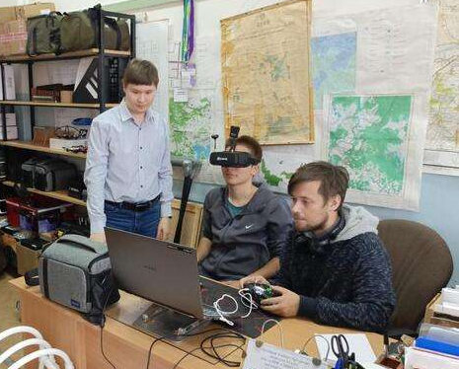
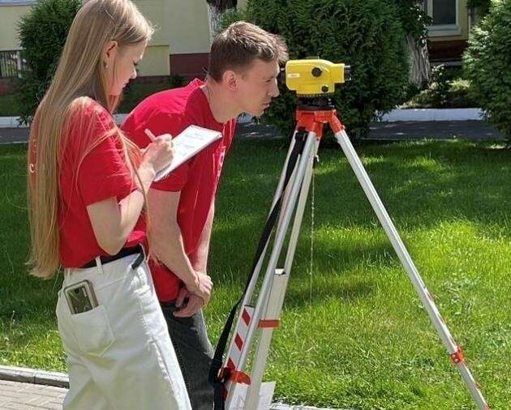
FACULTY OF LAND MANAGEMENT
BACHELOR'S DEGREE PROGRAMS
21.03.02 Land management and cadastre
Real Estate Cadastre
Land management
21.03.03 Geodesy and remote sensing
SPECIALIST’S DEGREE PROGRAMS
21.05.01 Applied Geodesy
- Engineering geodesy
MASTER'S DEGREE PROGRAMS
21.04.02 Land management and cadastre
- Management of land resources and real estate objects
21.04.03 Geodesy and remote sensing
WE WILL TEACH YOU
- conduct measurements using unmanned aerospace systems: drones and unmanned aerial vehicles
- analyze data from drones and unmanned aerial vehicles and generate accurate 3D terrain models using artificial intelligence
- manage the land and property complex of an enterprise, region, country
- create land development projects, investment and land management projects using GIS technologies

Slide 11
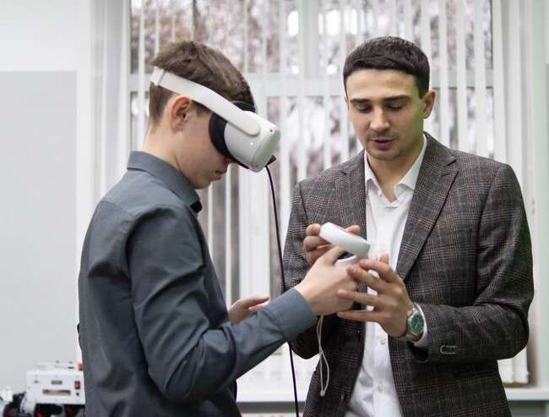
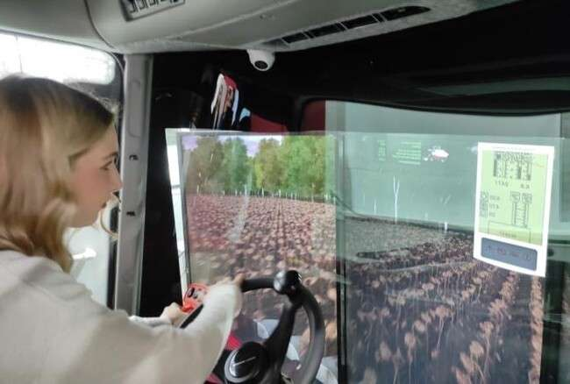
FACULTY OF TECHNICAL SERVICE OF AGROINDUSTRIAL COMPLEXES
BACHELOR'S DEGREE PROGRAMS
23.03.03 Operation of transport and technological machines and complexes
- Car service
35.03.06 Agroengineering
Digital systems in the agro-industrial complex
Technical service in the agro-industrial complex
MASTER'S DEGREE PROGRAMS
23.04.03 Operation of transport and technological machines and complexes
- Car service
35.04.06 Agroengineering
Management of technological processes in the agro-industrial
complex
WE WILL TEACH YOU
- create modern agricultural machinery and units with intelligent control, automated unmanned systems
control technological processes of precision farming systems using artificial intelligence
control agricultural machinery without an operator, analyze harvest data using a smartphone
design car parts using 3D modeling

Slide 12
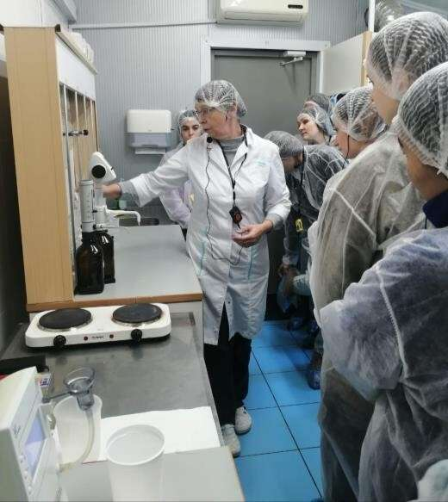
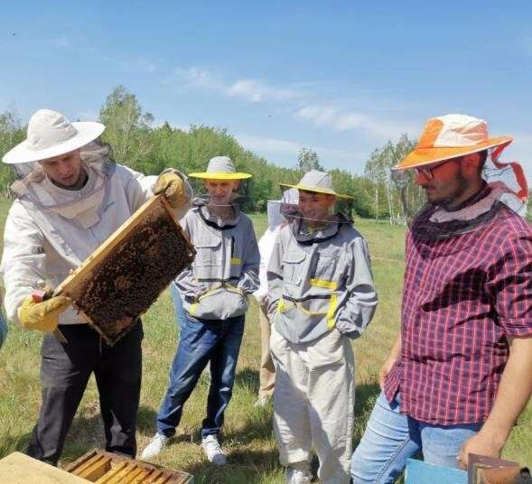
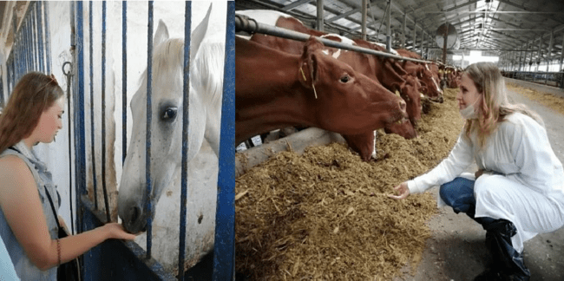
FACULTY OF ZOOTECHNY
BACHELOR'S DEGREE PROGRAMS
36.03.02 Zootechny
IT technologies in animal husbandry
Zootechnology and agribusiness
MASTER'S DEGREE PROGRAMS
36.04.02 Zootechny
Technology of production of animal products
- Management of breeding and
technological processes in animal husbandry
WE WILL TEACH YOU
- model selection and breeding work
develop technologies for increasing animal productivity using marker selection
use methods for assessing the breeding value of farm animals and poultry (index breeding)
develop models of genetic correction
implement programs of targeted selection

Slide 13
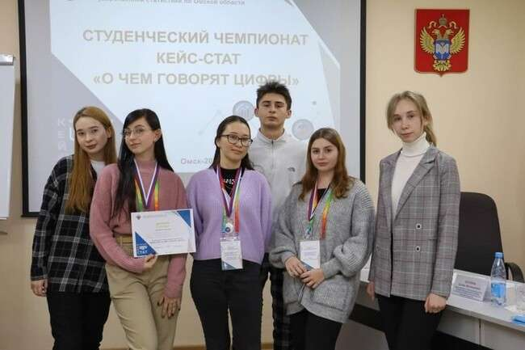
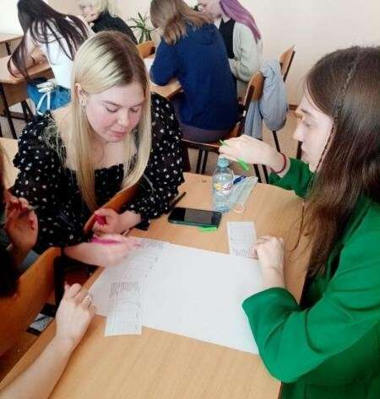
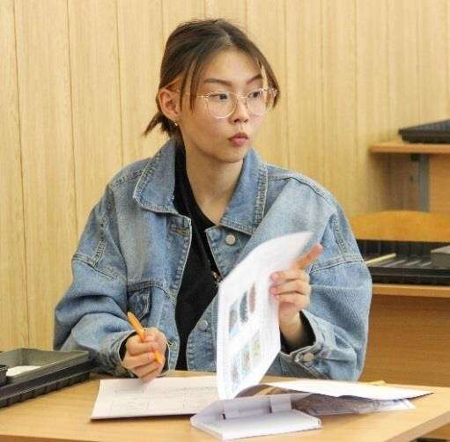
FACULTY OF ECONOMICS
BACHELOR'S DEGREE PROGRAMS
09.03.02 Information systems and technologies
- Information systems and technologies in business
38.03.01 Economics
Finance and credit
Accounting, analysis and audit
Accounting, control and financial analysis in business
Applied Economics and Finance
38.03.02 Management
Production management
State and municipal administration
Economics and organization management
40.03.01 Jurisprudence
- Civil law
MASTER'S DEGREE PROGRAMS
09.04.02 Information systems and technologies
38.04.01 Economics
Accounting, economic analysis
and financial control
Business analytics and financial
management
38.04.02 Management
Management of organizations
40.04.01 Jurisprudence
WE WILL TEACH YOU
use artificial intelligence methods to process and analyze data
"see the life" of enterprises behind the numbers, managing cash flows
organize the work of the team for the successful implementation of projects
resolve disputes in civil, family, land, inheritance,
corporate, labor, insurance cases

Slide 14

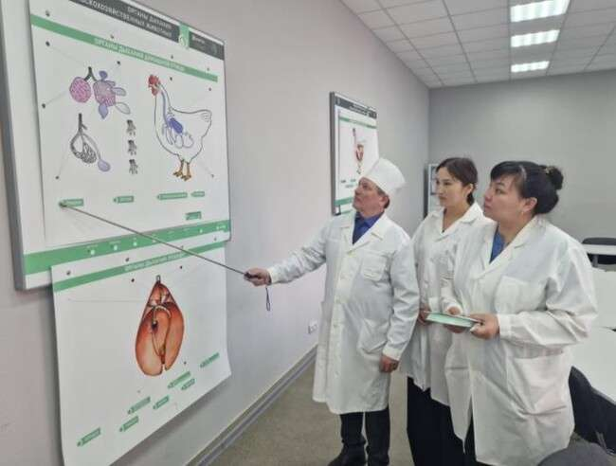
DEPARTMENT OF POSTGRADUATE AND DOCTORAL STUDIES
POSTGRADUATE PROGRAMS
1.5.15 Ecology
1.5.19 Soil science
1.5.21 Physiology and biochemistry of plants
1.6.15 Land management, cadastre and land monitoring
1.6.22 Geodesy
4.1.1 General agriculture and crop production
4.1.2 Plant breeding, seed production and biotechnology
4.1.3 Agrochemistry, agro-soil science, plant protection and quarantine
4.1.5 Melioration, water management and agrophysics
4.2.1 Animal pathology, morphology, physiology, pharmacology and toxicology
4.2.2 Sanitation, hygiene, ecology, veterinary and sanitary expertise and biosafety
4.2.3 Infectious diseases and animal immunology
4.2.4 Private animal husbandry, feeding, technologies of feed preparation and production of livestock products
4.3.1 Technologies, machinery and equipment for the agro-industrial complex
4.3.5. Biotechnology of food and biologically active substances
5.2.3 Regional and sectoral economy

Slide 15
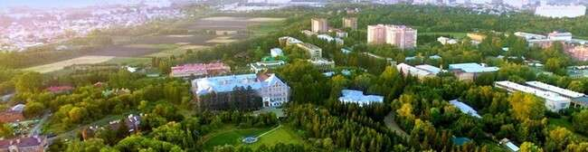
UNIQUE AND MODERN CAMPUS INFRASTRUCTURE
12 DORMITORIES
5 SPORT COMPLEXES AND A SWIMMING POOL
STUDENT CULTURE PALACE
STUDENT CAFES AND FOOD OUTLETS
GROCERY STORES, ONLINE GOODS DISCHARGE POINTS FROM INTERNATIONAL INTERNET SITES
POLYCLINIC AND CHAIN OF PHARMACIES
EDUCATIONAL AND EXPERIMENTAL FARM, BOTANICAL GARDEN, ARBORETUM AND LAKE
SCIENTIFIC AGRICULTURAL LIBRARY
DIGITAL SITUATION CENTER
CENTER OF YOUTH INITIATIVES
BUSINESS INCUBATOR
STUDENT DESIGN BUREAU
VETERINARY CLINIC
MORE THAN 20 MODERN RESEARCH LABORATORIES AND CARBON POLYGON
LAUNDRY CHAIN
3 BUS STOPS WITHIN WALKING DISTANCE

Slide 16
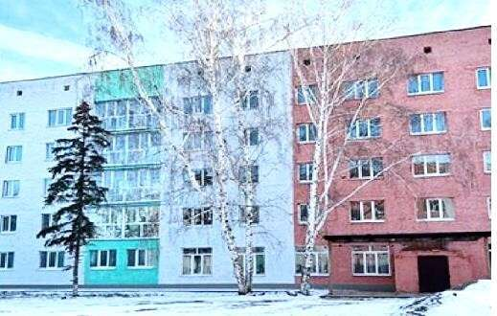
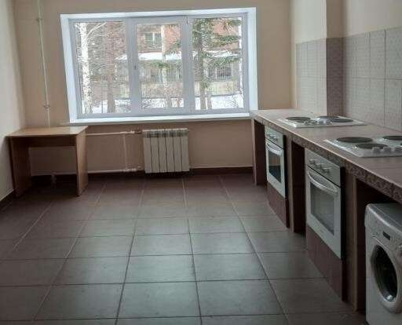

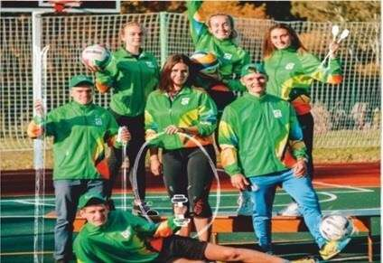

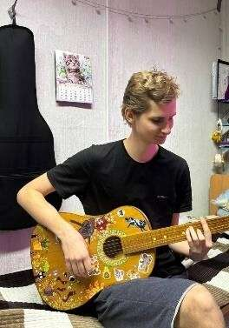
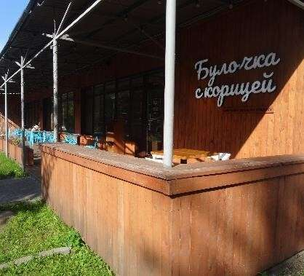
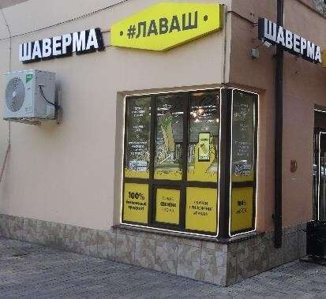
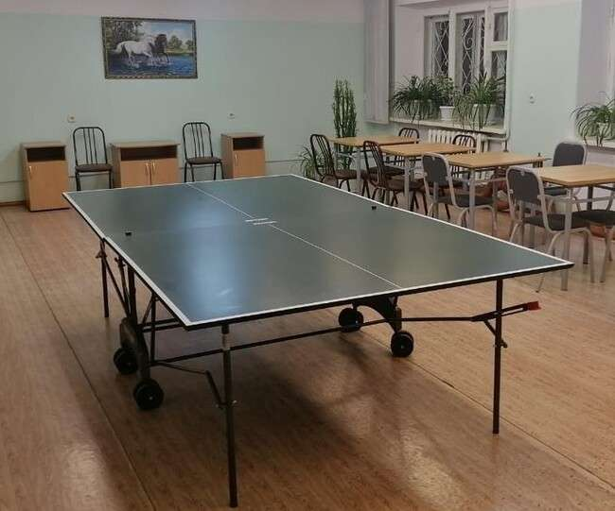
UNIQUE AND MODERN CAMPUS INFRASTRUCTURE
100% PLACES AVAILABLE IN DORMITORIES FOR FOREIGN CITIZENS
DOUBLE AND TRIPLE FURNISHED ROOMS (THE COST PER SEAT IS $17.23 PER MONTH)
THE DORMITORIES ARE EQUIPPED WITH SHOWER AND BATHROOMS, KITCHENS, LAUNDRY FACILITIES AND ROOMS FOR
INDEPENDENT WORK AND FREE TIME

Slide 17
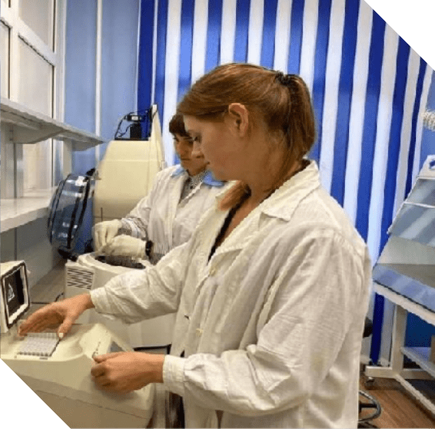
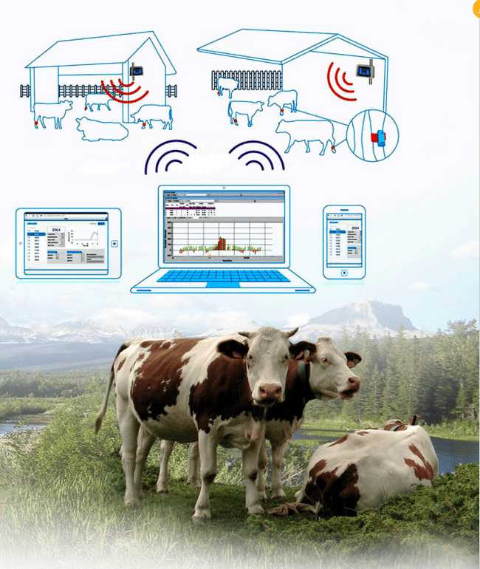
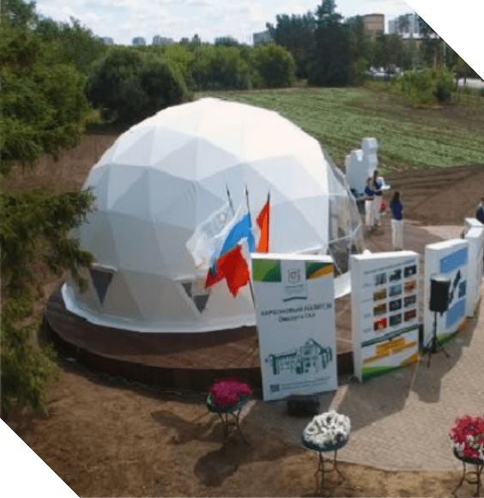
RESEARCH PRIORITIES
BREEDING AND GENETICS IN PLANT PRODUCTION
EFFICIENT ANIMAL FARMING
ECOLOGY AND CLIMATE
"Digital and genetic technologies in animal husbandry"
"Environmental Impact Assessment for Agricultural Production"
"Agricultural crops of the future"
International breeding and genetic center and world-class laboratory
Cabron Proving Ground
of Omsk SAU

Slide 18

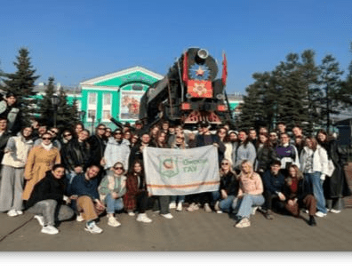

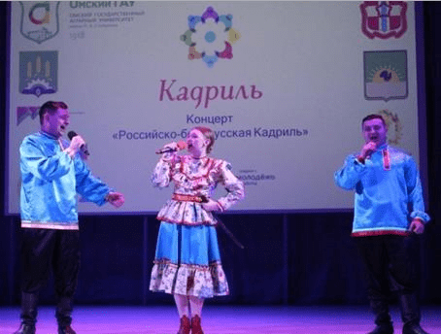
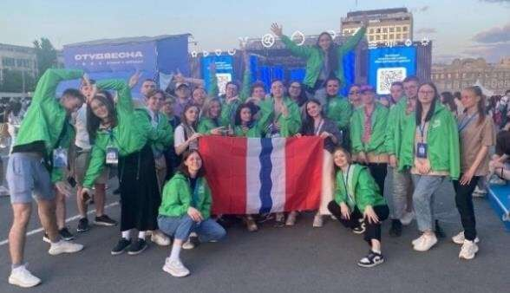
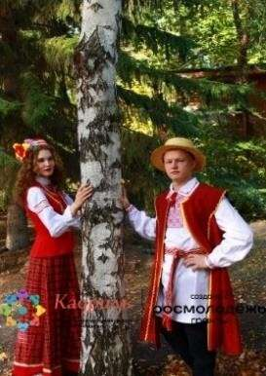
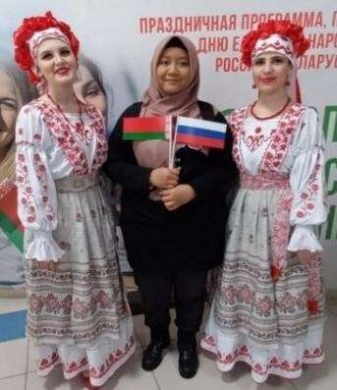


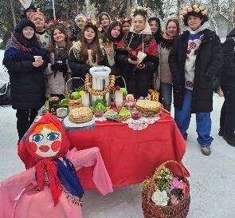
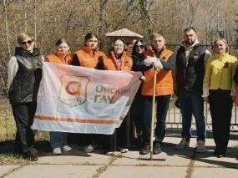
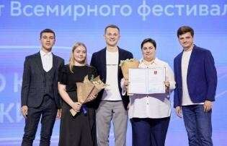
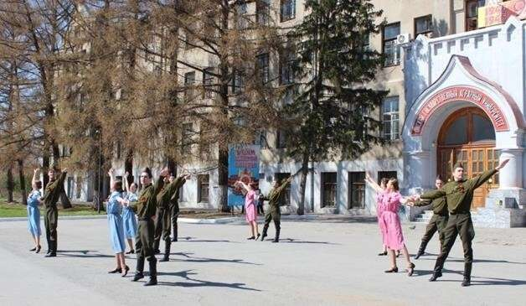
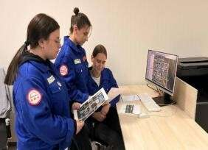

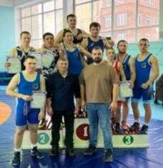


YOUTH POLICY
University Student Council
Intercultural Student Center
Student Media Service
Student activists of the Student Palace of Culture
Volunteer Center "Globus"
Student brigades
Student sports club
"Sapsan"
Student law enforcement squad "Kirovets"
Historical and Local History Club "CLIO"

Slide 19
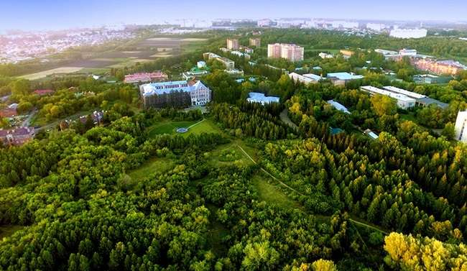



WELCOME TO OMSK SAU
INTERNATIONAL RELATIONS
DEPARTMENT
Head: Anastasia Kriklivaya Address: 644008 Russia, Omsk region, Omsk, 1 Institutskaya Ploshchad, offices 403, 428, 429
Phone: +7 (3812) 65-10-72
E-mail: omgau.int@mail.ru; mezhd.otd@omgau.org
www.omgau.ru
ADMISSION BOARD
t.me/omskiygau

Slide 20
OMSK SAU PROGRAMS OF HIGHER EDUCATION 2026/2027
BACHELOR'S AND SPECIALIST DEGREES PROGRAMS
Code | Name of direction of training (specialty) | Tuition fee per year, USD (as of May 31, 2025)
05.03.06 | Ecology and Environmental Engineering | 2035.28
09.03.02 | Information Systems and Technologies | 2428.72
19.03.01 | Biotechnology | 2035.28
19.03.02 | Food Products from Plant Raw Materials | 2035.28
19.03.03 | Food products of Animal Origin | 2035.28
20.03.01 | Technosphere Safety | 2035.28
20.03.02 | Environmental Engineering and Water Use | 2035.28
21.03.02 | Land Management and Cadastres | 2428.72
21.03.03 | Geodesy and Remote Sensing | 2428.72
23.03.03 | Operation of Transport and Technological Machines and Complexes | 2035.28
35.03.01 | Forestry | 2035.28

Slide 21
OMSK SAU PROGRAMS OF HIGHER EDUCATION 2026/2027
BACHELOR'S AND SPECIALIST DEGREES PROGRAMS
Code | Name of direction of training (specialty) | Tuition fee per year, USD (as of May 31, 2025)
35.03.03 | Agrochemistry and Agrosoil Sciences | 2035.28
35.03.04 | Agronomy | 2035.28
35.03.05 | Gardening | 2035.28
35.03.06 | Agroengineering | 2035.28
36.03.01 | Veterinary and Sanitary Examination | 2035.28
36.03.02 | Zootechny | 2035.28
38.03.01 | Economics | 1798.21
38.03.02 | Management | 1798.21
40.03.01 | Jurisprudence | 1798.21
21.05.01 | Applied Geodesy | 2428.72
36.05.01 | Veterinary Medicine | 2035.28

Slide 22
OMSK SAU PROGRAMS OF HIGHER EDUCATION 2026/2027
MASTER'S DEGREE PROGRAMS
Code | Name of direction of training (specialty) | Tuition fee per year, USD (as of May 31, 2025)
05.04.06 | Ecology and Environmental Engineering | 2180.30
09.04.02 | Information Systems and Technologies | 2180.30
19.04.02 | Food Products from Plant Raw Materials | 2180.30
19.04.03 | Food Products from Animal Origin | 2180.30
19.04.05 | High-tech Production of Functional and Specialized Food Products | 2180.30
20.04.01 | Technosphere Safety | 2180.30
20.04.02 | Environmental Engineering and Water Use | 2180.30
21.04.02 | Land Management and Cadastres | 2569.95
21.04.03 | Geodesy and Remote Sensing | 2569.95
23.03.03 | Operation of Transport and Technological Machines and Complexes | 2180.30

Slide 23
OMSK SAU PROGRAMS OF HIGHER EDUCATION 2026/2027
MASTER'S DEGREE PROGRAMS
Code | Name of direction of training (specialty) | Tuition fee per year, USD (as of May 31, 2025)
27.04.01 | Standardization and Metrology | 2180.30
35.04.03 | Agrochemistry and Agrosoil Sciences | 2180.30
35.04.04 | Agronomy | 2180.30
35.04.05 | Gardening | 2180.30
35.04.06 | Agroengineering | 2180.30
35.04.10 | Hydromelioration | 2180.30
36.04.01 | Veterinary and Sanitary Examination | 2180.30
36.04.02 | Zootechny | 2180.30
38.04.01 | Economics | 1941.97
38.04.02 | Management | 1941.97
40.04.01 | Jurisprudence | 1941.97

Slide 24
OMSK SAU PROGRAMS OF HIGHER EDUCATION 2026/2027
POSTGRADUATE PROGRAMS
Code | Name of direction of training (specialty) | Tuition fee per year, USD (as of May 31, 2025)
1.5.15. | Ecology | 2397.19
1.5.21. | Physiology and Biochemistry of Plants | 2397.19
1.6.15. | Land Management, Cadastres and Land Monitoring | 2397.19
1.6.22. | Geodesy | 2397.19
4.1.1. | General Agriculture and Crop Production | 2397.19
4.1.2. | Plant Breeding, Seed Production and Biotechnology | 2397.19
4.1.3. | Agrochemistry, Agrosoil Science, Plant Protection and Quarantine | 2397.19
4.1.5. | Land Reclamation, Water Management and Agrophysics | 2397.19
4.2.1. | Animal Pathology, Morphology, Physiology, Pharmacology and Toxicology | 2397.19
4.2.2. | Sanitation, Hygiene, Ecology, Veterinary and Sanitary Expertise and Biosafety | 2397.19
4.2.3. | Infectious Diseases and Animal Immunology | 2397.19
4.2.4. | Private Animal Husbandry, Feeding, Technologies of Feed Preparation and Production of Livestock Products | 2397.19
4.3.1. | Technologies, Machinery and Equipment for the Agro-industrial Complex | 2397.19
4.3.5. | Biotechnology of Food and Biologically Active Substances | 2397.19
5.2.3. | Regional and Sectoral Economics | 2326.58

